Slide 1
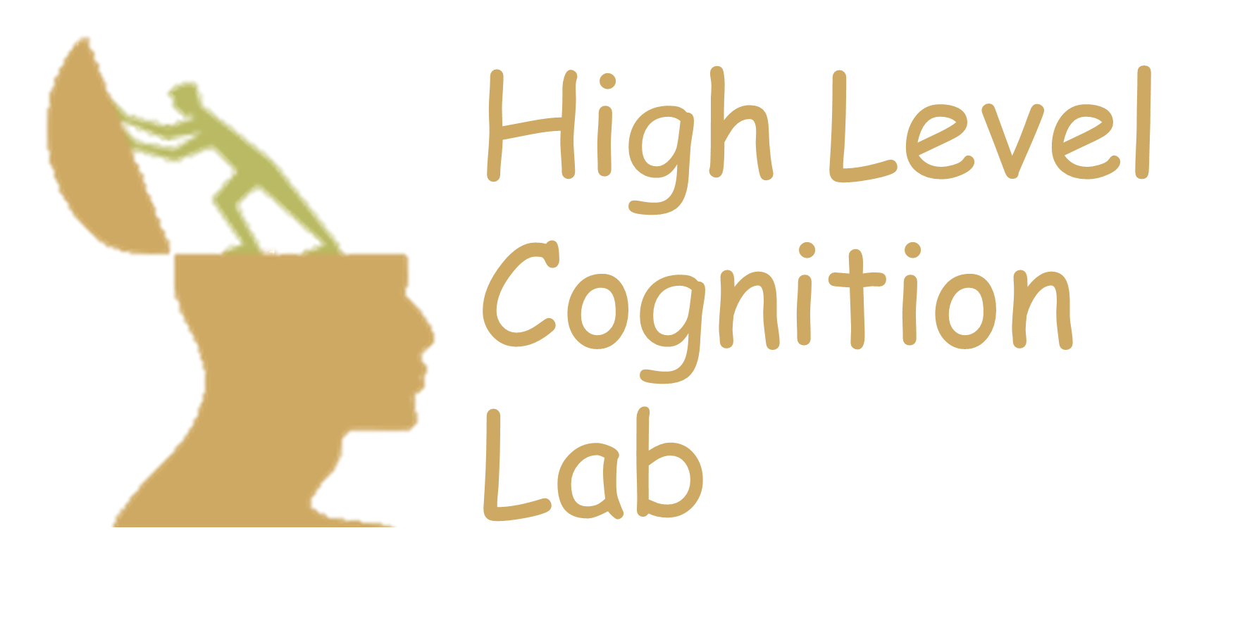


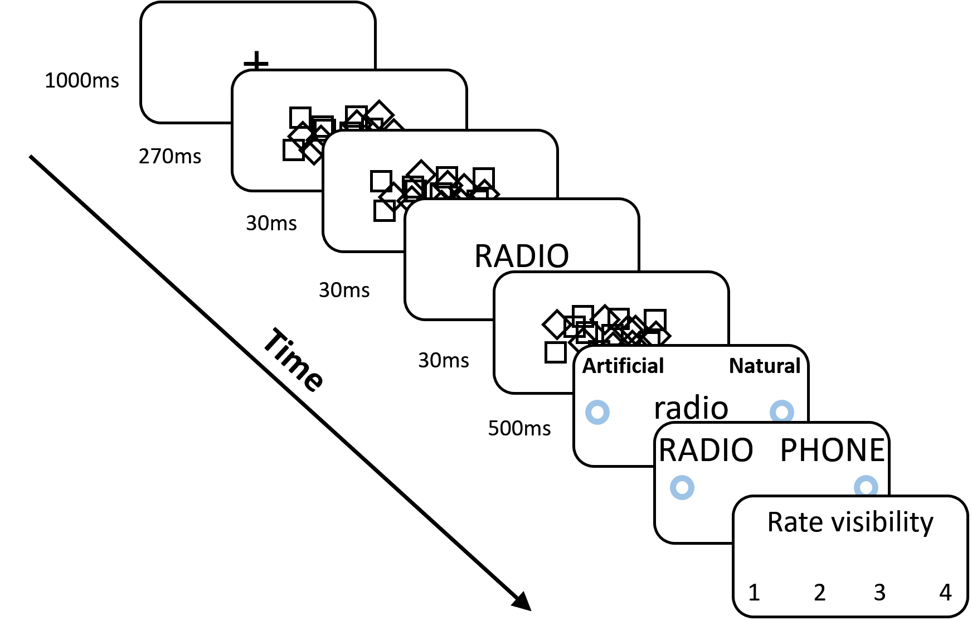
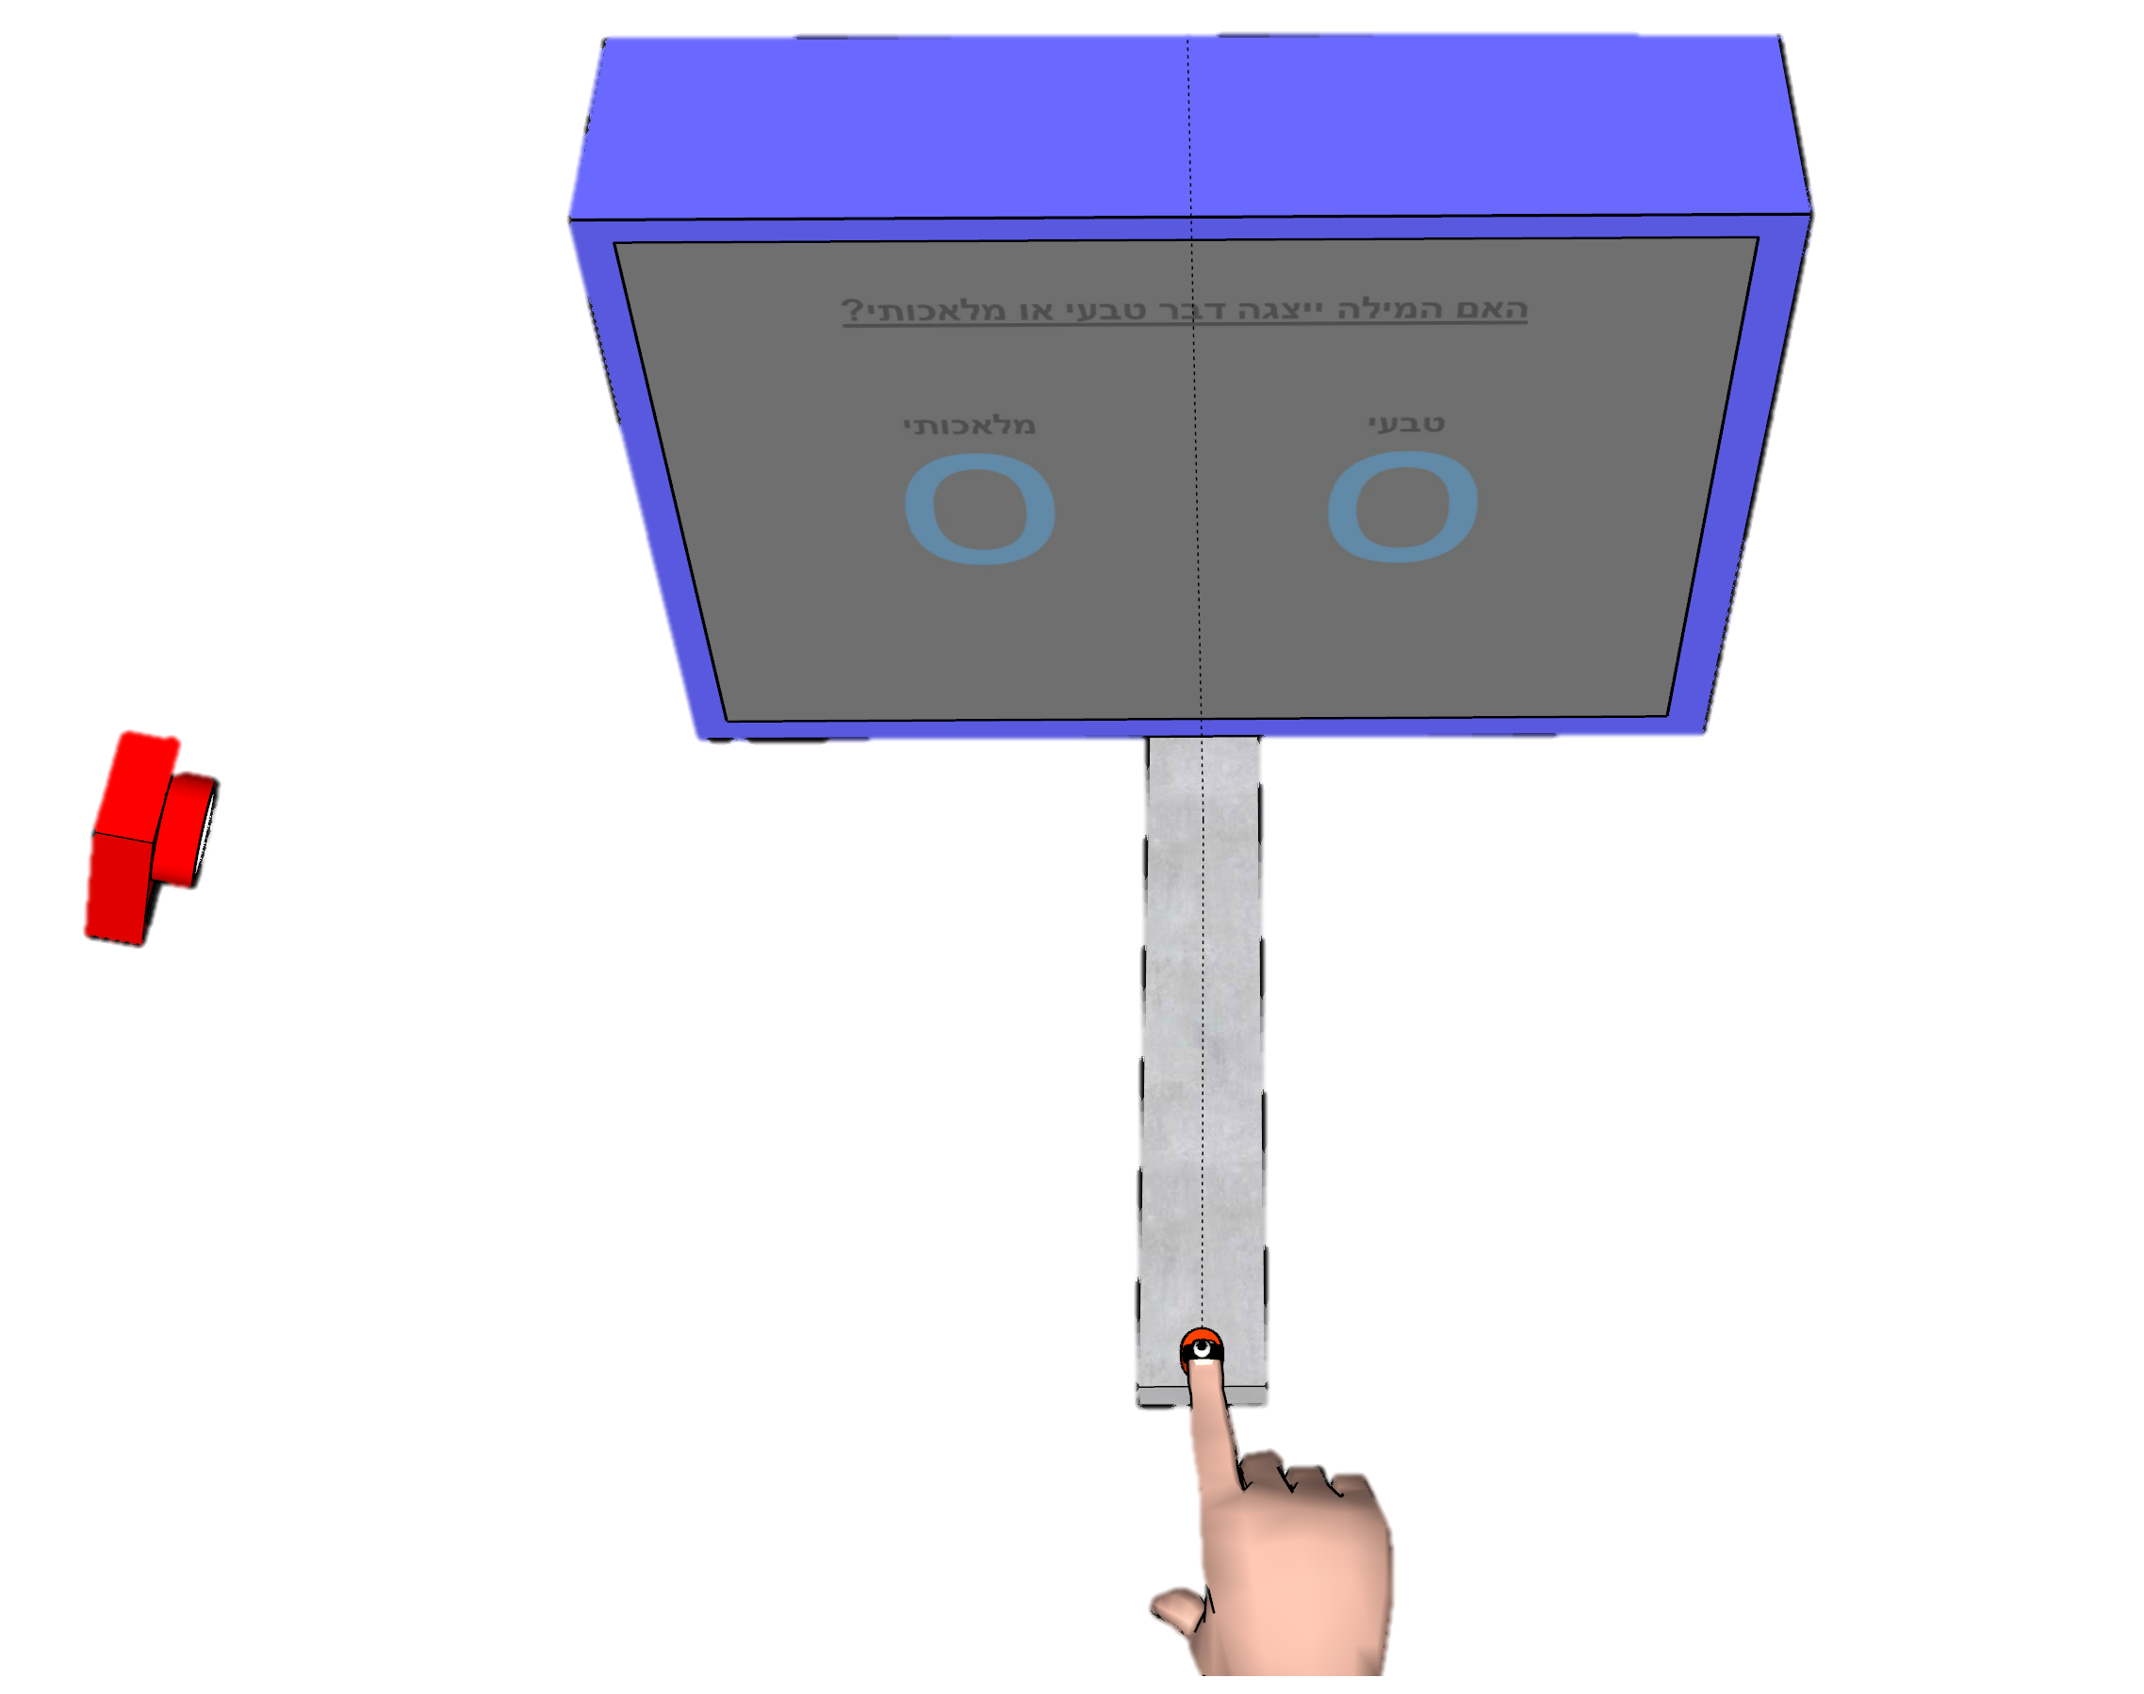
Show some sensitivity! Using motion tracking to improve unconscious measures
Khen Heller¹, Craig S. Chapman^{3,4,} and Liad Mudrik^{1,2}
¹ Sagol School of Neuroscience, Tel Aviv University; ² School of Psychological Sciences, Tel Aviv University; ³ Faculty of Kinesiology, Sport, and Recreation, University of Alberta, Edmonton, AB, Canada; ⁴ Neuroscience and Mental Health Institute University of Alberta Edmonton, Alberta, Canada
1
Introduction
Methods
1
2
Unconscious effect are hard to detect.
Motion tracking allows a continuous and richer measure.
Motion tracking was used to unravel unconscious priming effects [1-5].
Only one study compared motion tracking with keyboard response [6].
Further support is necessary to verify the superiority of motion tracking as a measure of unconscious processing.
Design Task Measure
Classify target as natural / artificial [7] RA: reach area between
average paths to the left and right targets
Pilot 2
N = 11
Practice day
Trials = 240
+
Test day
Trials = 560
Practice
6 blocks, w/o prime
Screen
Practice
1 block, w/o prime
Practice
1 block, with prime
Test
12 blocks, with prime
RA
Y
Z
Z
Pilot 1
N = 10
Test day
Trials = 560
X
3
Results
X
Effect Size Comparison
Effect comparable to previous papers
Larger than keyboard RT effect.
Average Trajectory Reach Area
Motion tracking yields a significant effect for unconscious priming.
Pilot 1 Pilot 2 Pilot 1 Pilot 2
Motion
Tracking
RA
*
Mouse
Tracking
AUC
Motion
Tracking
RA
*
*
Keyboard
RT
AUC – area under the curve, area between optimal and actual paths to the target. RA – Reach area, area between average trajectories to the left and to the right targets. Shaded areas represent CI. Error bars represent SE. * = p<0.05
References:
[1] Finkbeiner, M., & Friedman, J. (2011). The Flexibility of Nonconsciously Deployed Cognitive Processes: Evidence from Masked Congruence Priming. PLoS ONE, 6(2), e17095; [2] Friedman, J., & Finkbeiner, M. (2010). Temporal dynamics of masked congruence priming: Evidence from reaching trajectories. Proceedings of the 9th Conference of the Australasian Society for Cognitive Science, 98–105; [3] Finkbeiner, M., Song, J.-H., Nakayama, K., & Caramazza, A. (2008). Engaging the motor system with masked orthographic primes: A kinematic analysis. Visual Cognition, 16(1), 11–22; [4] Cressman, E. K., Franks, I. M., Enns, J. T., & Chua, R. (2007). On-line control of pointing is modiﬁed by unseen visual shapes. Consciousness and Cognition, 11; [5] Almeida, J., Mahon, B. Z., Zapater-Raberov, V., Dziuba, A., Cabaço, T., Marques, J. F., & Caramazza, A. (2014). Grasping with the eyes: The role of elongation in visual recognition of manipulable objects. Cognitive, Affective, & Behavioral Neuroscience, 14(1), 319–335; [6] Xiao, K., Yamauchi, T., & Bowman, C. (n.d.). Assessing Masked Semantic Priming: Cursor Trajectory versus Response Time Measures. 7; [7] Dehaene, S., Naccache, L., Cohen, L., Bihan, D. L., Mangin, J.-F., Poline, J.-B., & Rivière, D. (2001). Cerebral mechanisms of word masking and unconscious repetition priming. Nature Neuroscience, 4(7), 752–758.

